Slide 1
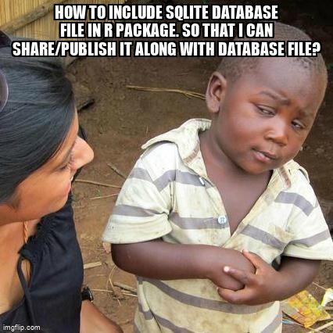
Lesson 21: Relational data II
SE370 – Computer-Aided Systems Engineering
MAJ Jae Kim DSE- Instructor

Slide 2
Today
Lesson 21: Relational data II
  1. Understand the advantages and disadvantages of a relational database
  2. Create and query a relational database to answer simple questions
2

Slide 3
Next Time
Lesson 22: Data Visualization I
  1. Visualize and summarize data using ggplot2 for data exploration (or hypothesis generation)
  2. Understand and apply facets and aesthetics
  3. Use different geometric objects ("geoms") to represent data
3

